Slide 1

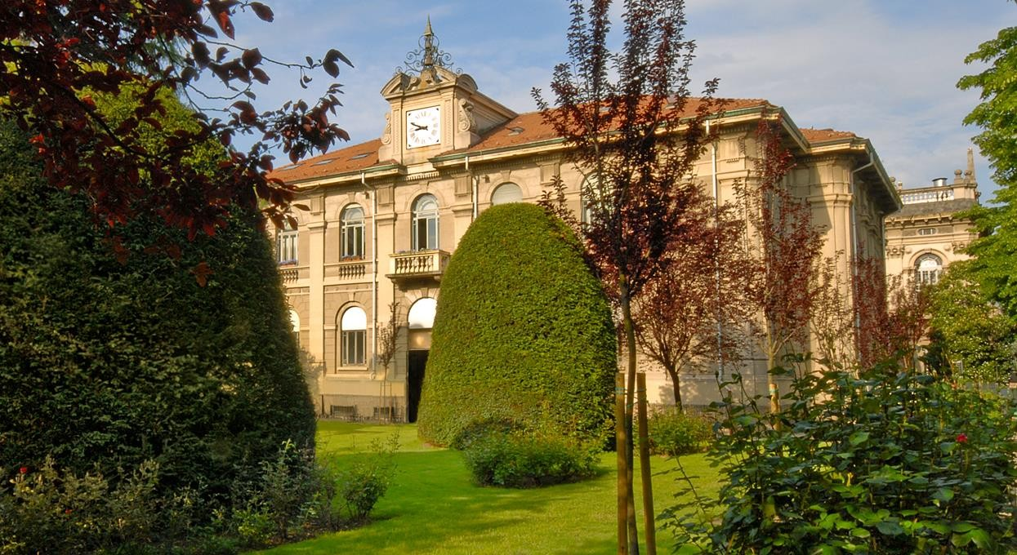

Earth Observation
Assessing Burn Severity Indexes for
Fire Mapping
using Mulstispectral Satellite Imagery
Lorenzo Carlassara 10601118
2022/2023

Slide 2
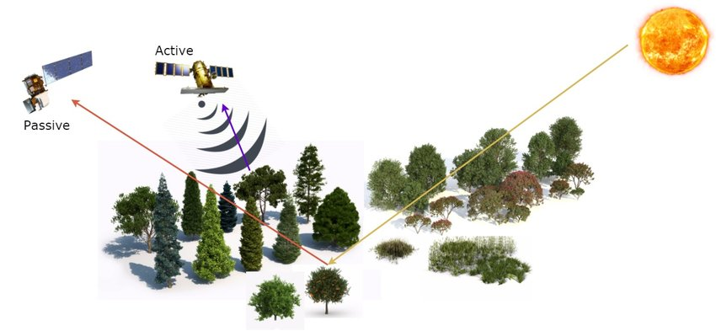
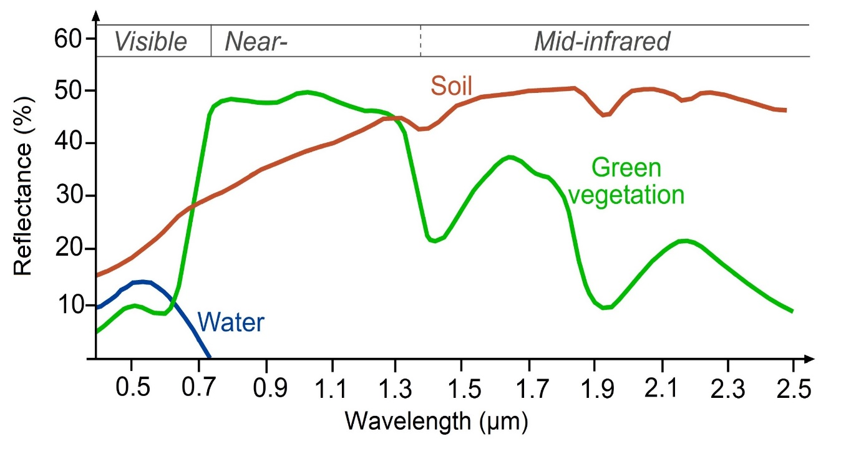

Multispectral Satellite
Spectral signature
https://www.researchgate.net/figure/Remote-sensing-from-satellite-active-and-passive-sensors_fig1_318470938
https://www.researchgate.net/figure/Typical-spectral-signatures-of-specic-land-cover-types-in-the-VIS-and-IR-region-of-the_fig2_326405082

Slide 3
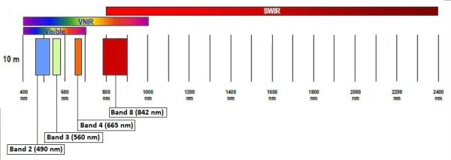
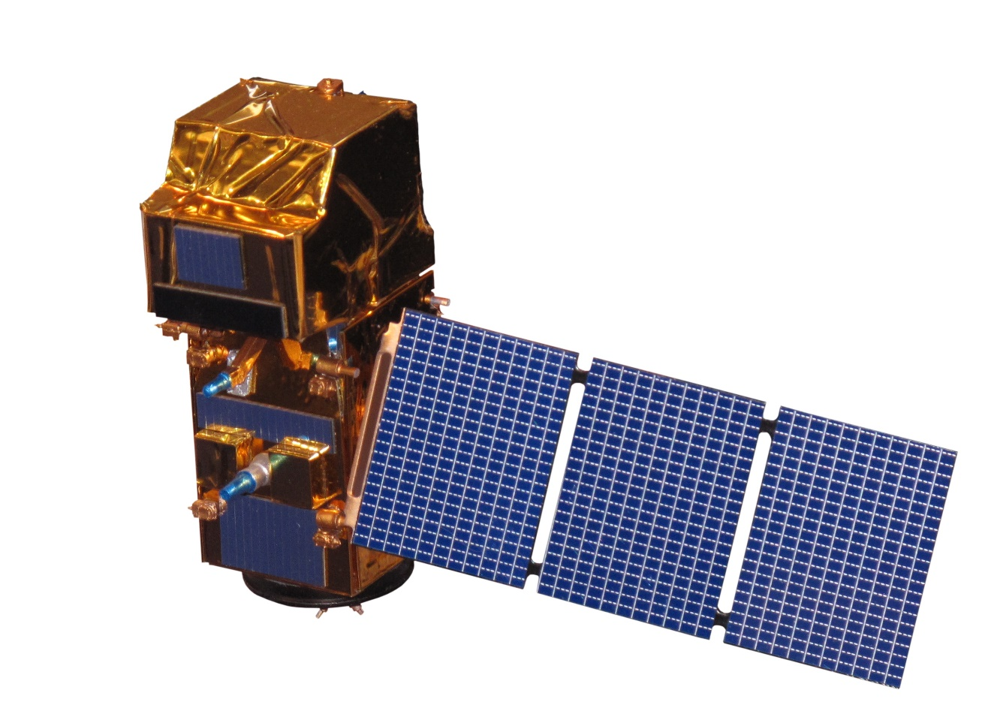
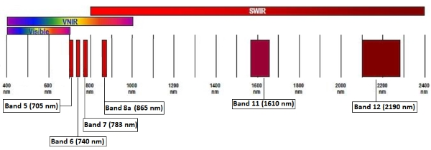
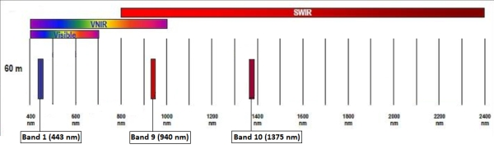
Sentinel-2 satellite
https://sentinels.copernicus.eu/web/sentinel/user-guides/sentinel-2-msi/resolutions/spatial
https://en.wikipedia.org/wiki/Sentinel-2#/media/File:Sentinel_2-IMG_5873-white_(crop).jpg

Slide 4
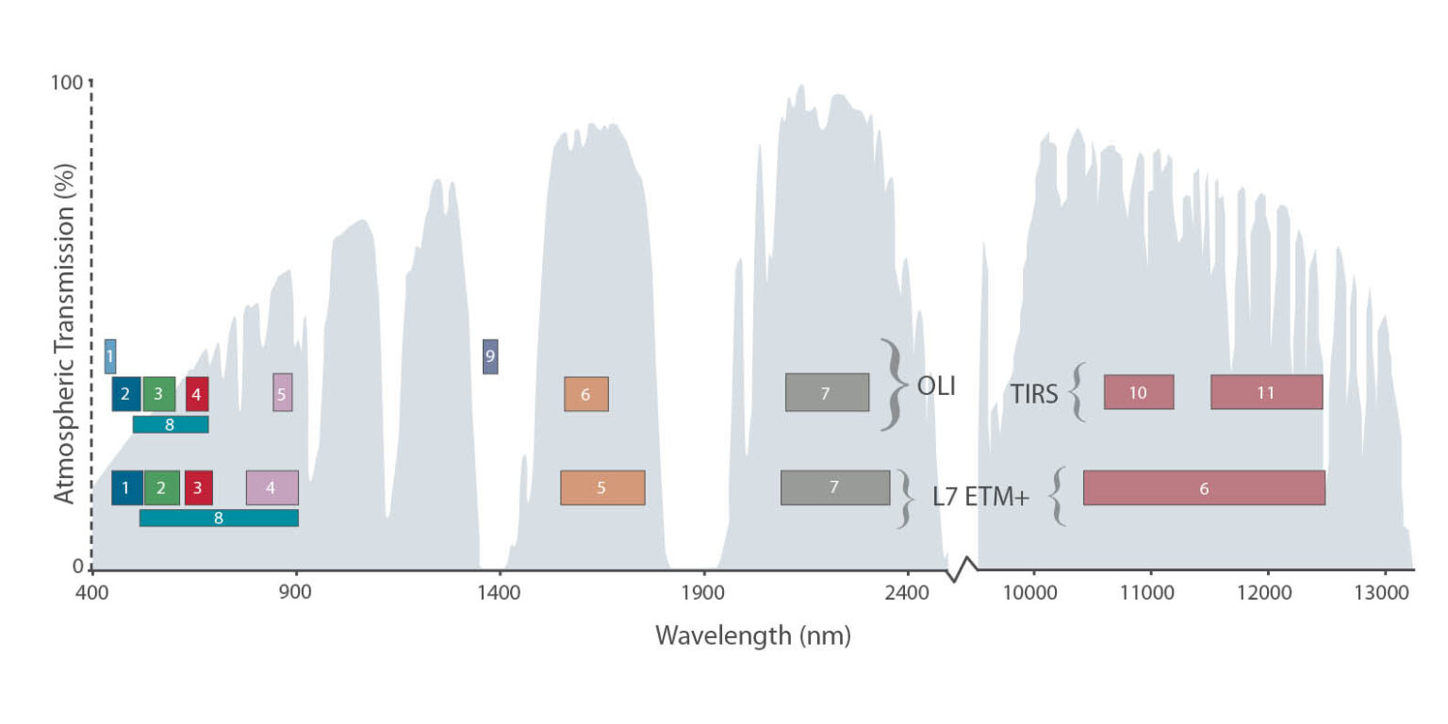
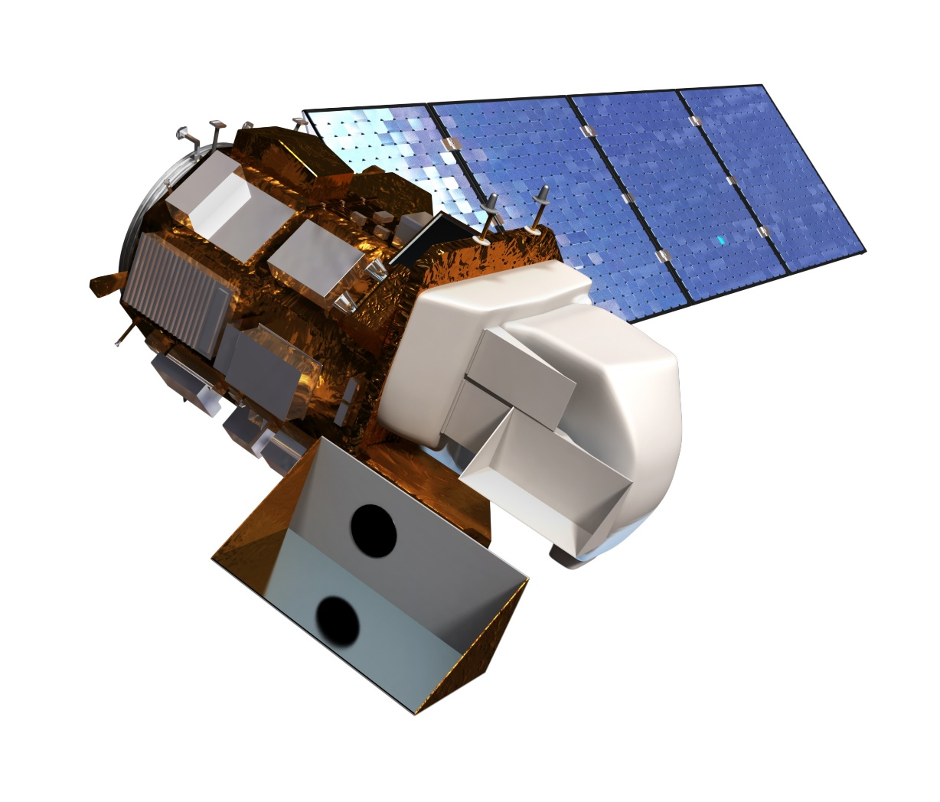
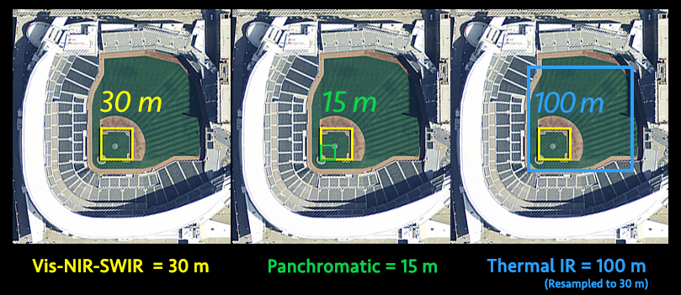
Landsat 8 satellite
https://landsat.gsfc.nasa.gov/satellites/landsat-8/
https://www.usgs.gov/media/images/landsat-8

Slide 5
https://un-spider.org/advisory-support/recommended-practices/recommended-practice-burn-severity/in-detail/normalized-burn-ratio

Slide 6
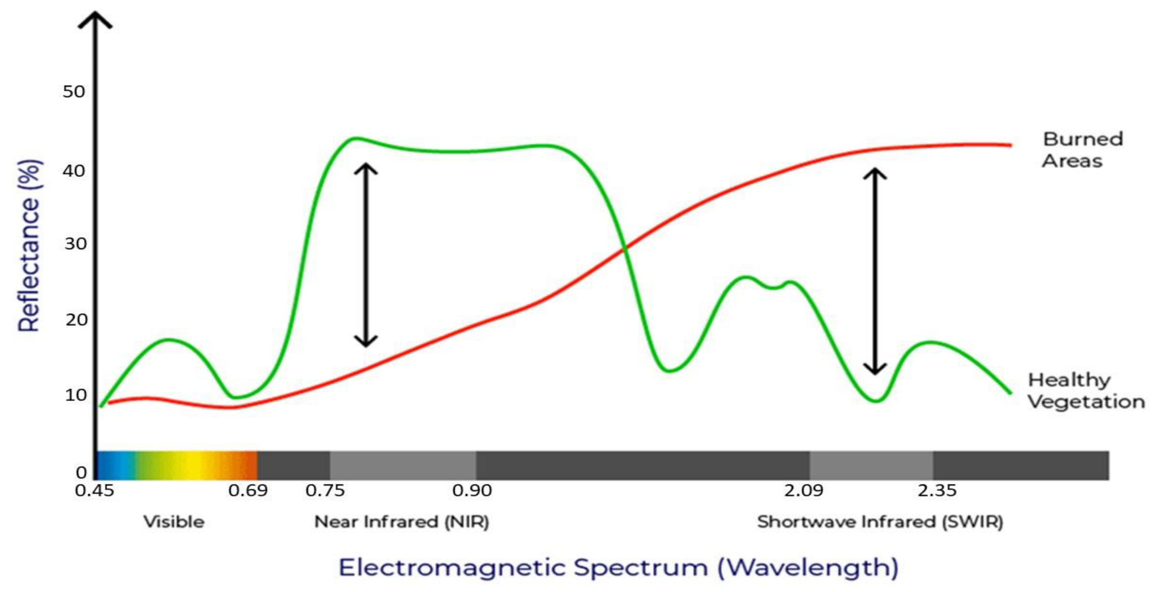
https://www.researchgate.net/figure/Comparison-of-the-spectral-response-of-healthy-vegetation-and-burned-areas-Source-USDA_fig4_359705541

Slide 7
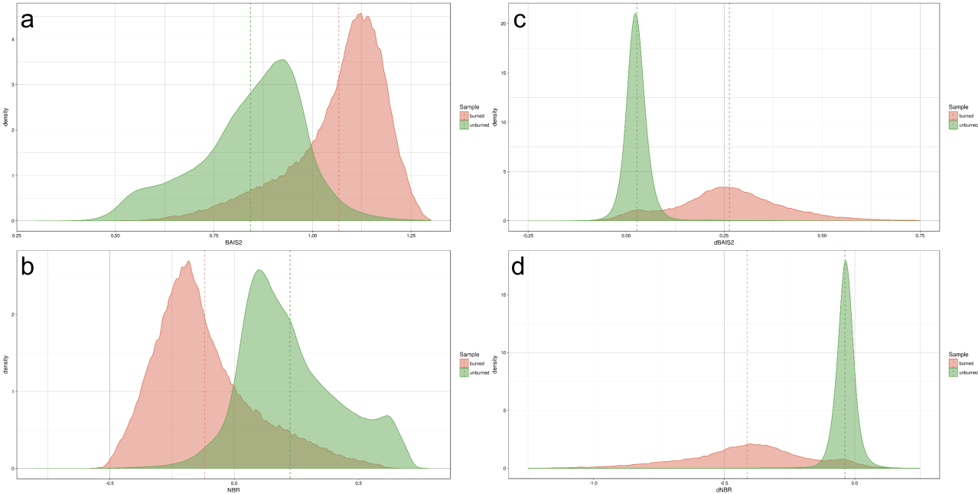

Slide 8
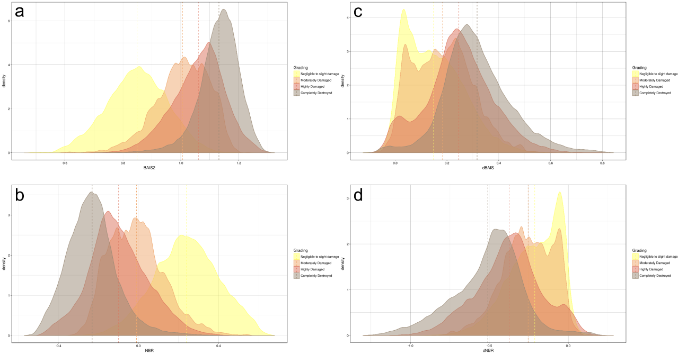

Slide 11
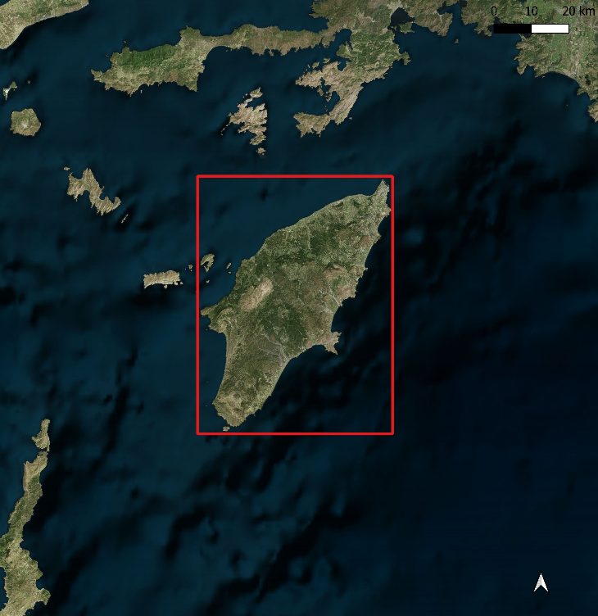
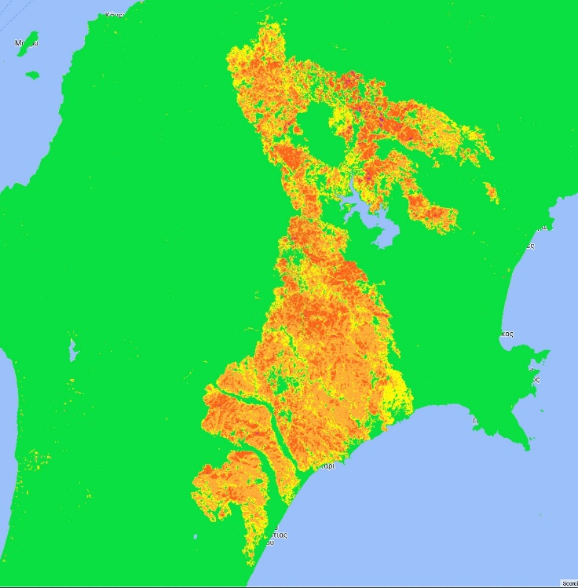
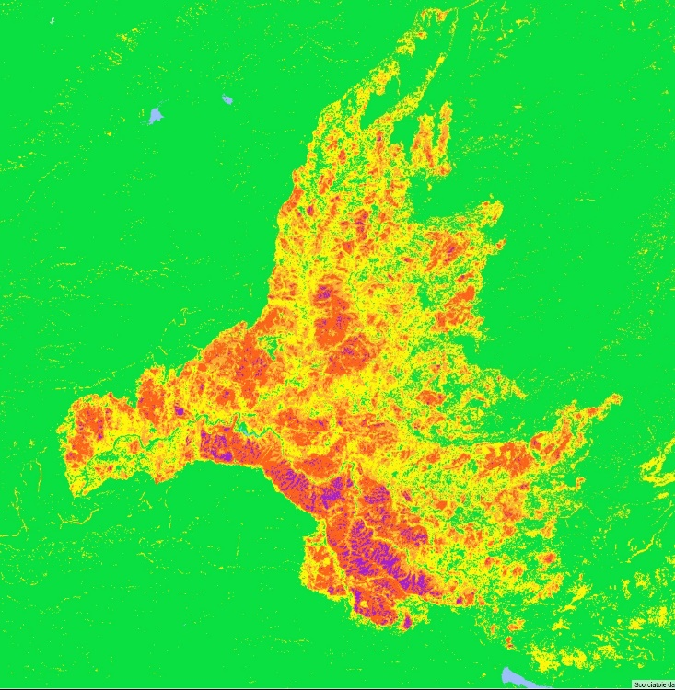
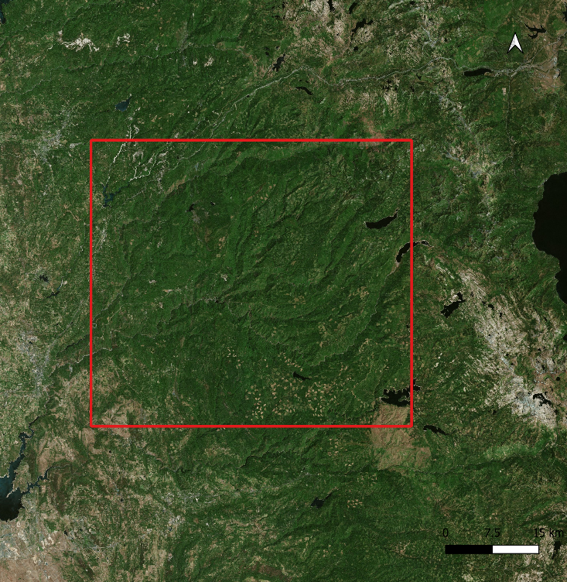
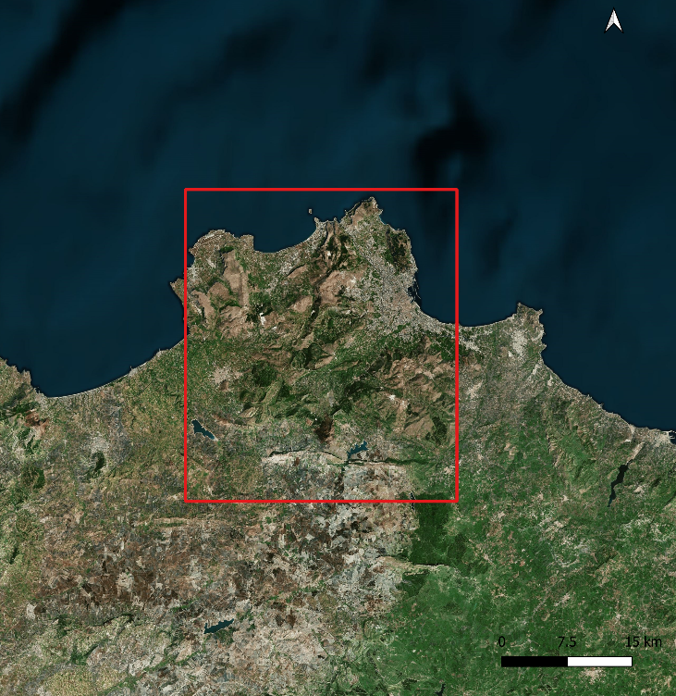
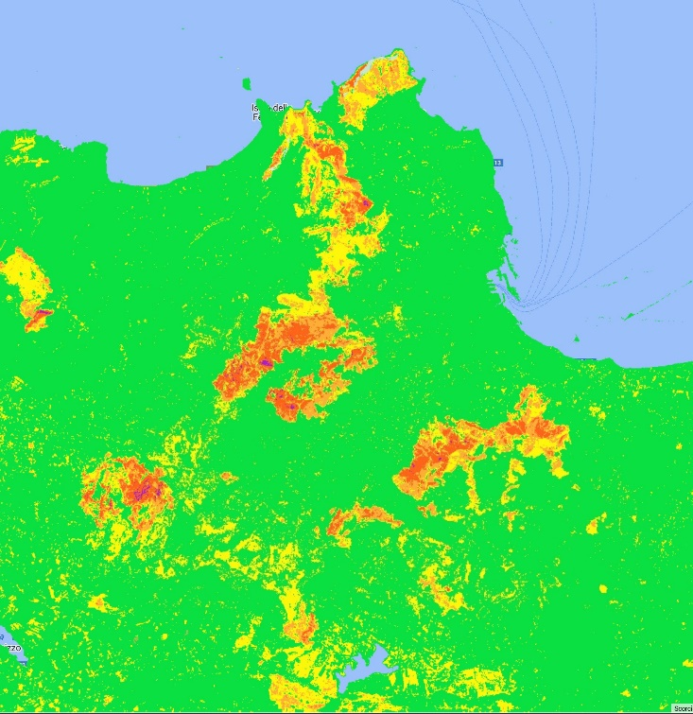
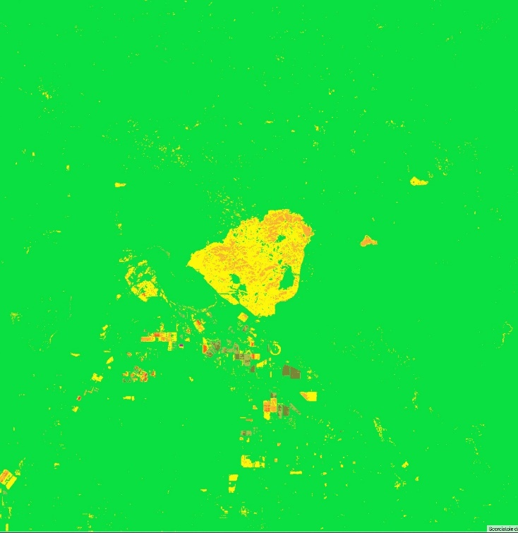
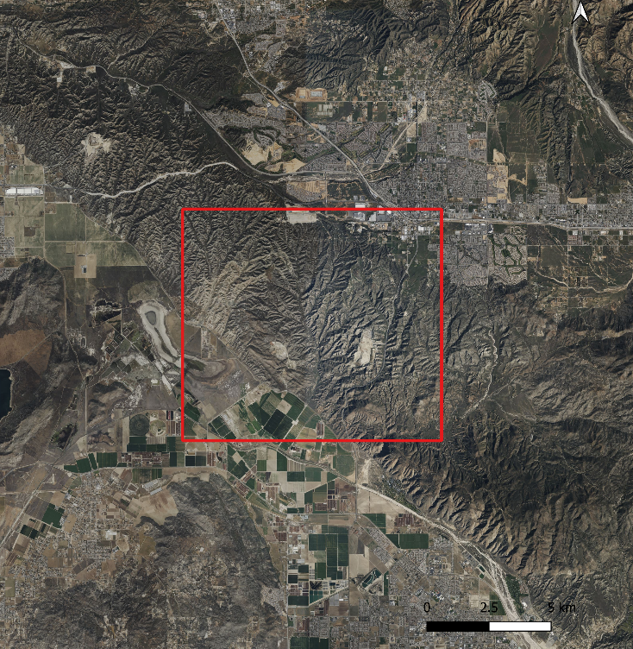
CRS: WGS 84 / Pseudo-Mercator

Slide 12
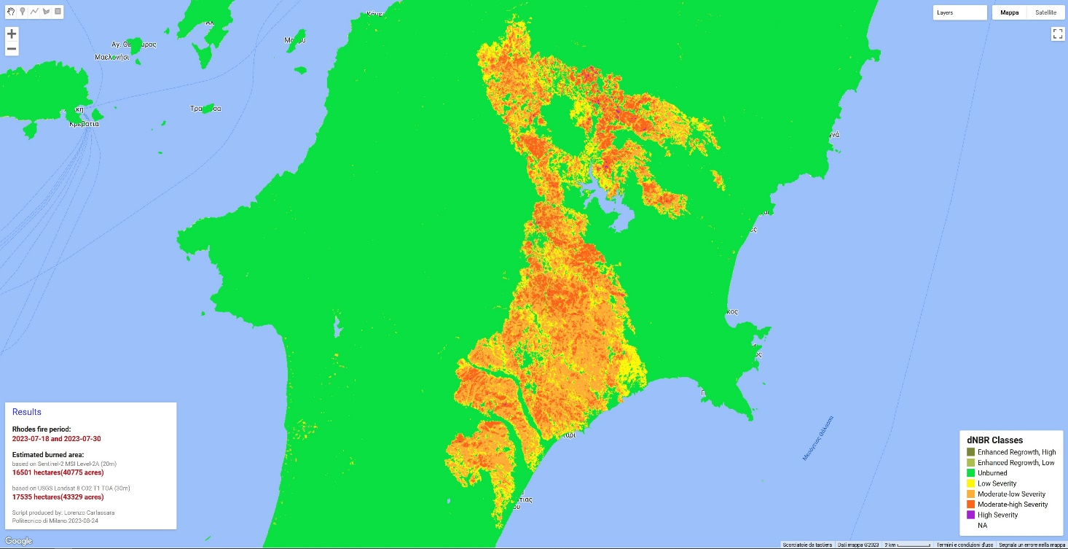
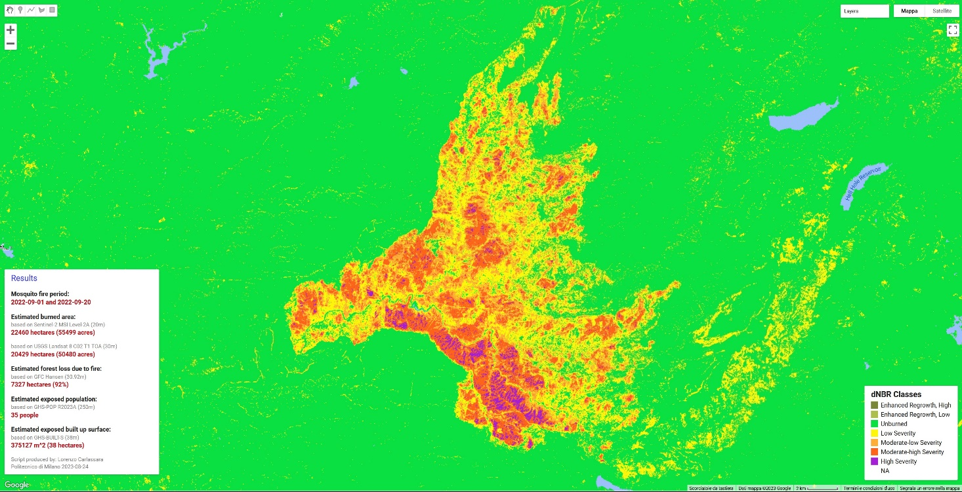
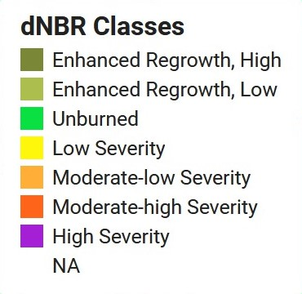
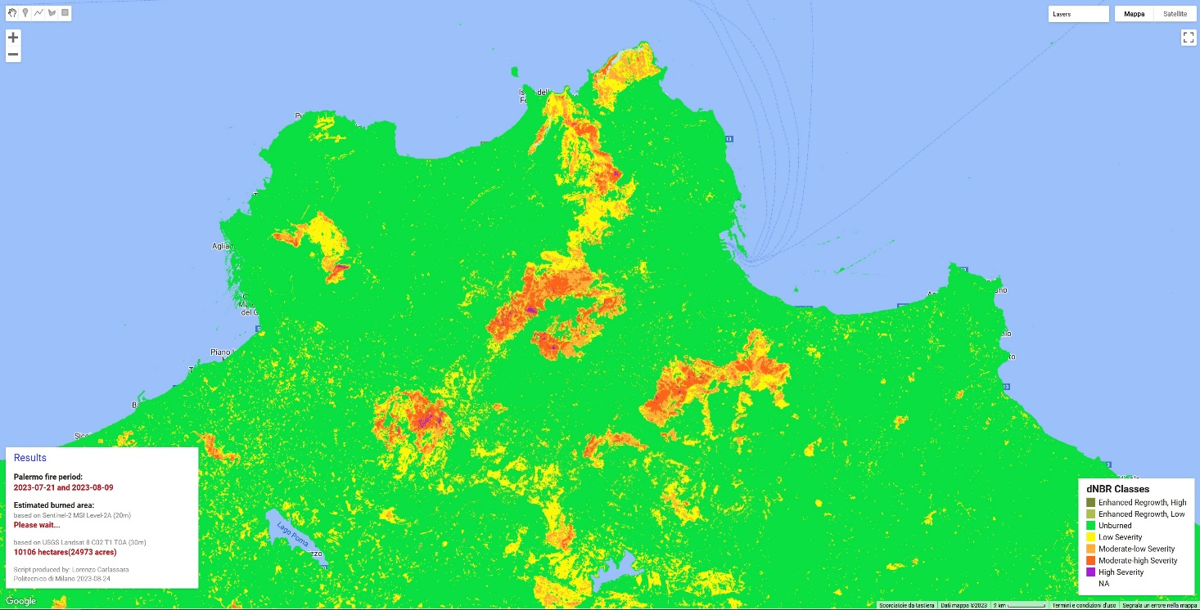
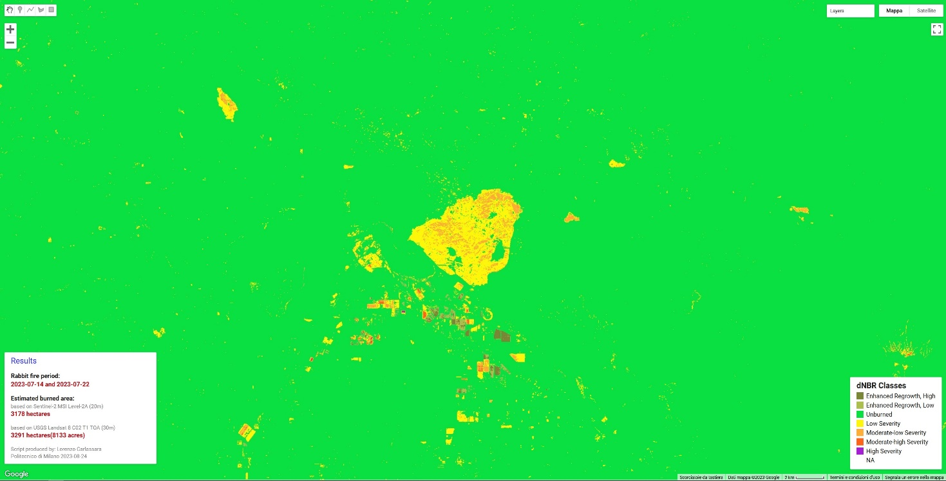
Sentinel-2

Slide 13
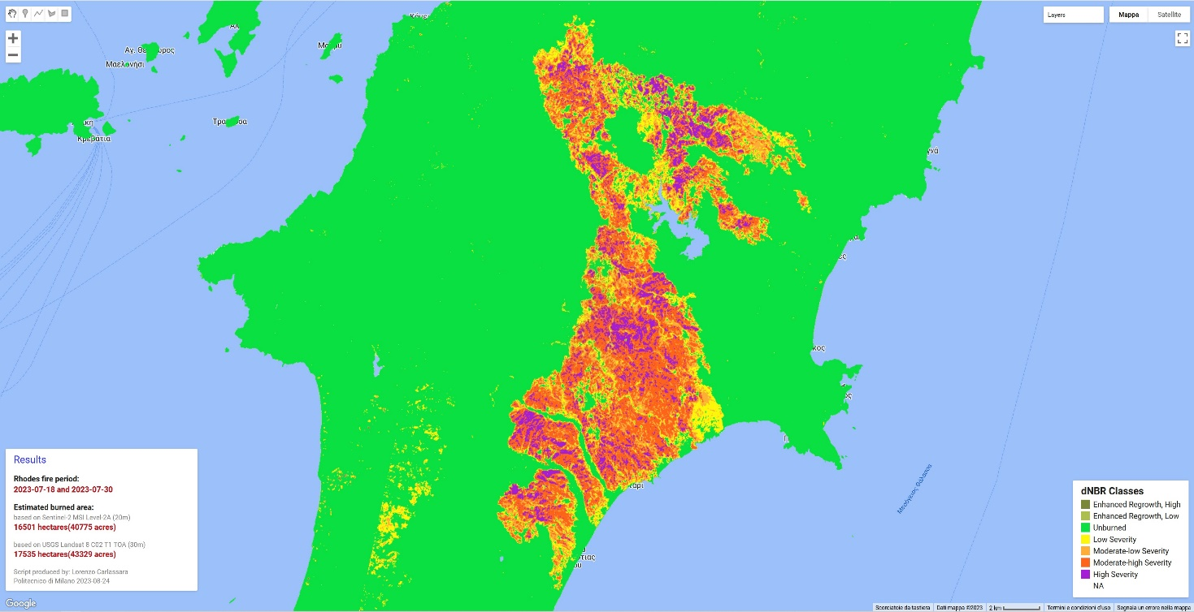
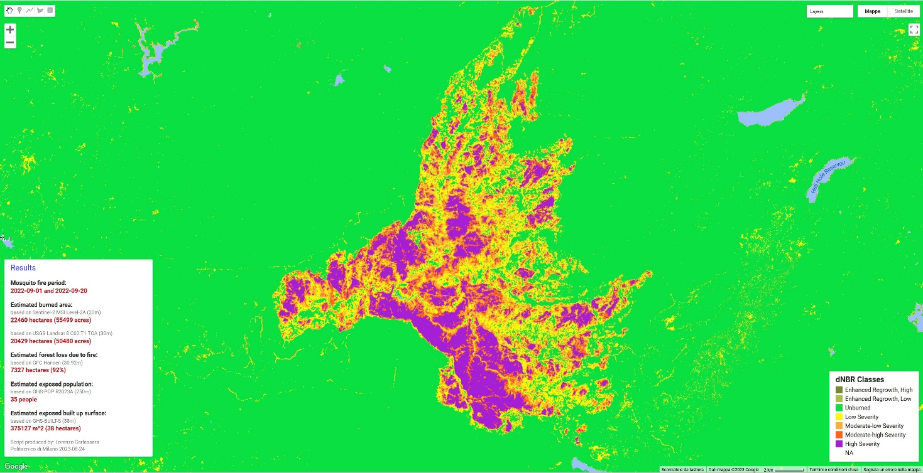
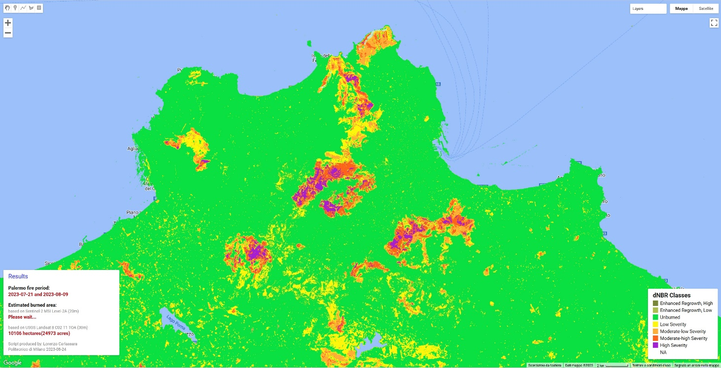
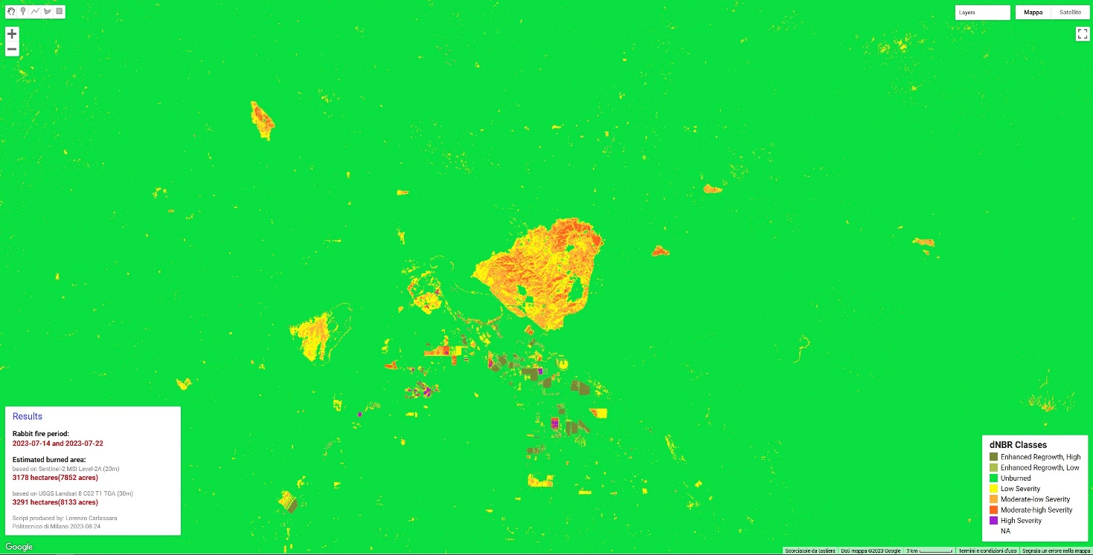
Landsat 8

Slide 14
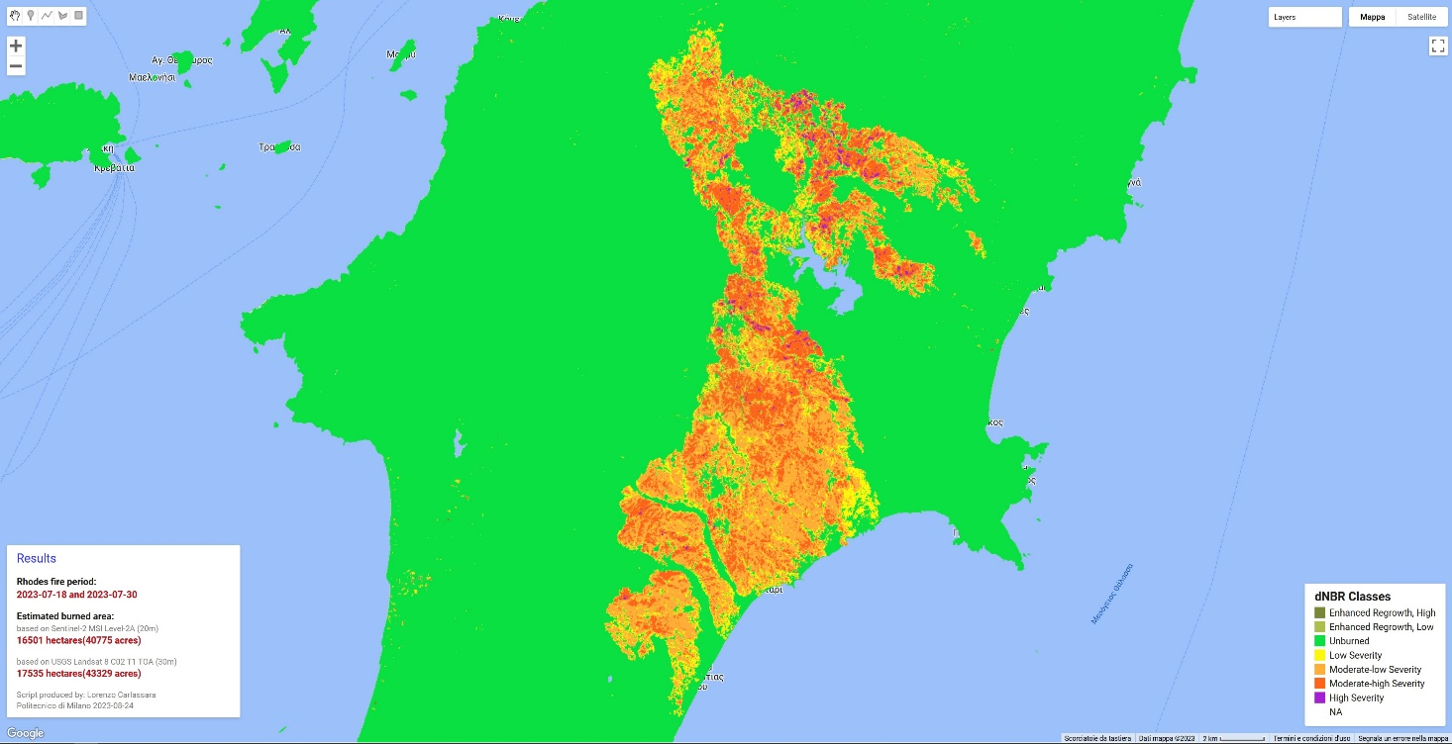
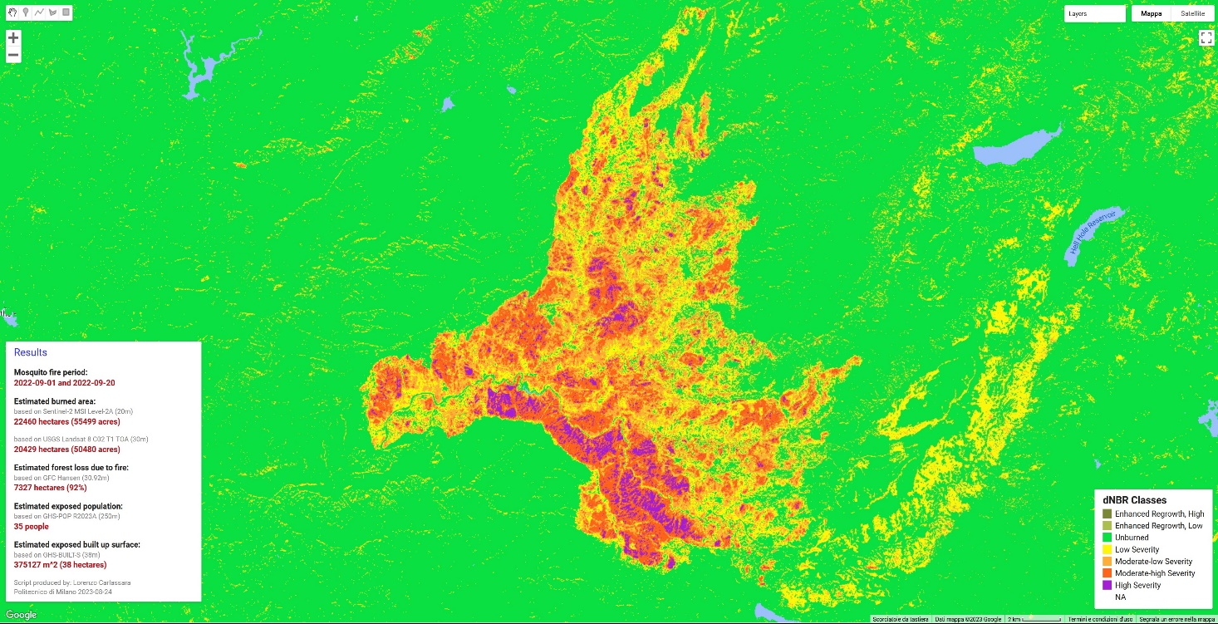
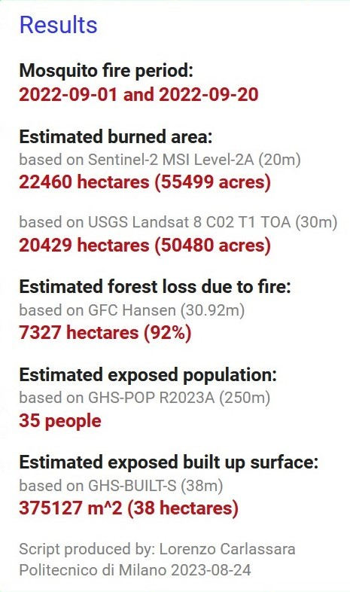
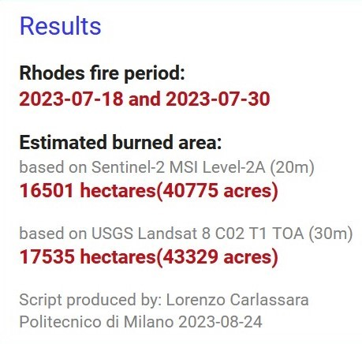
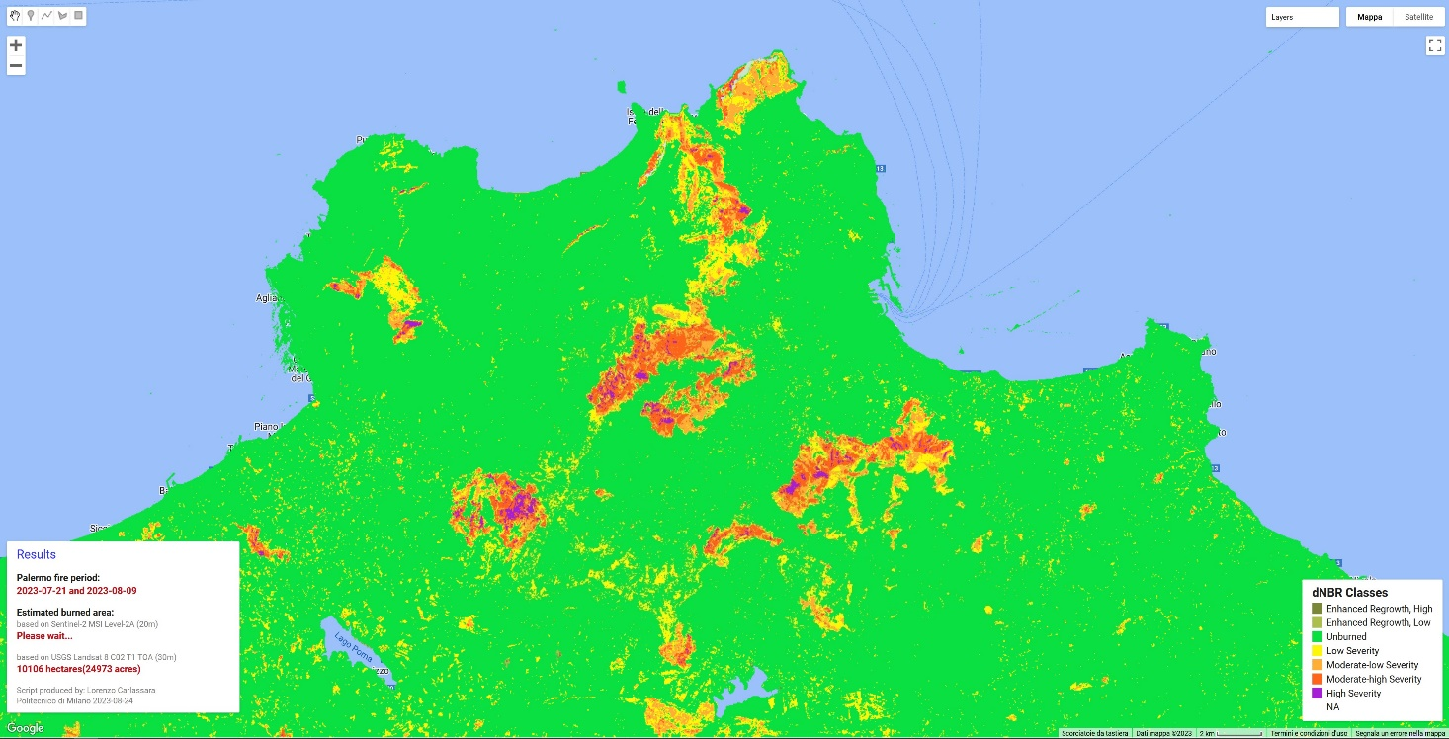
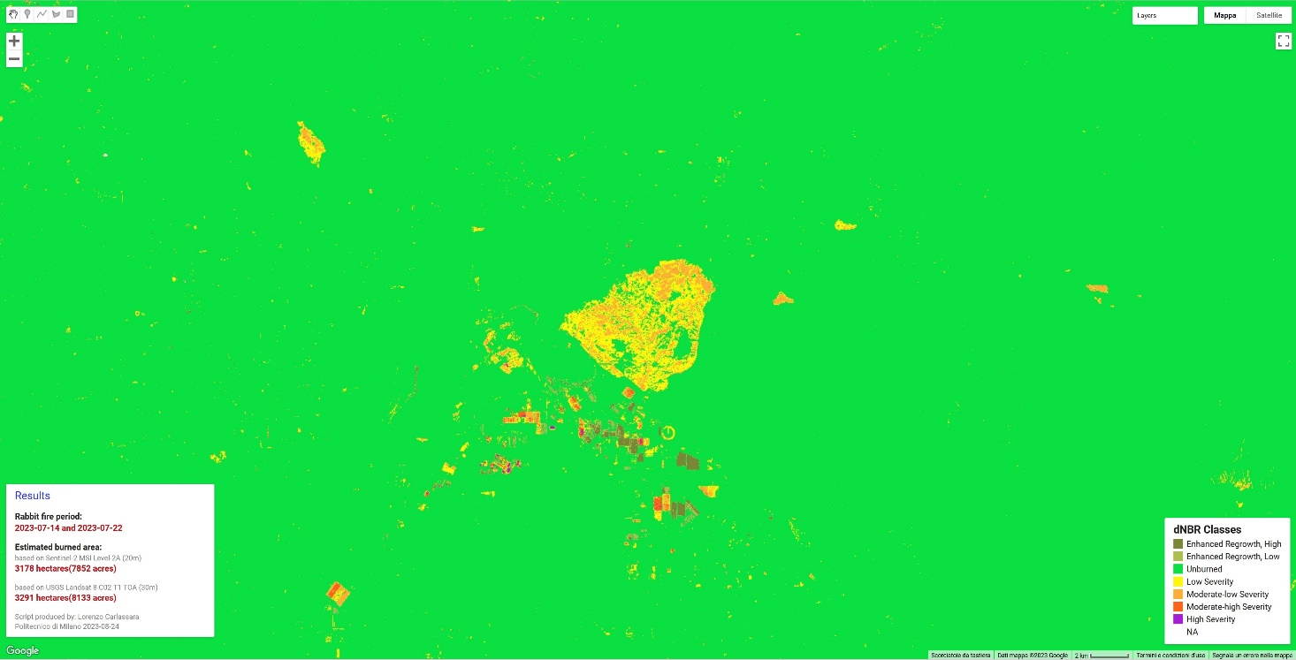
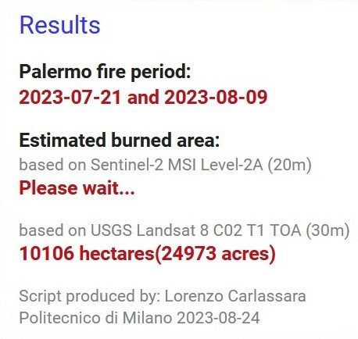
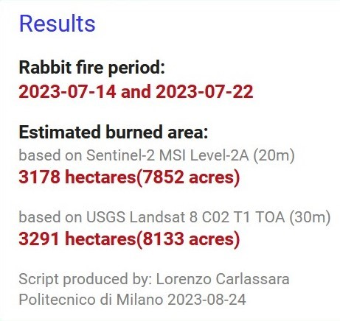
dBAIS2

Slide 15
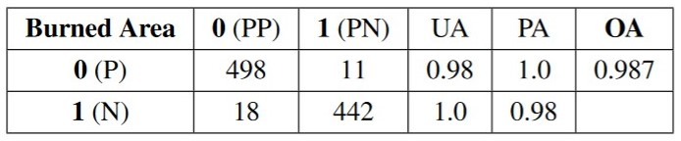
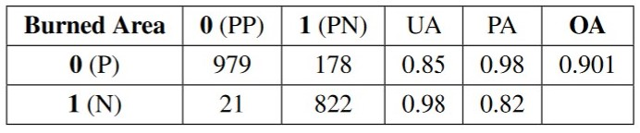
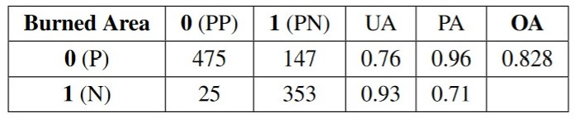
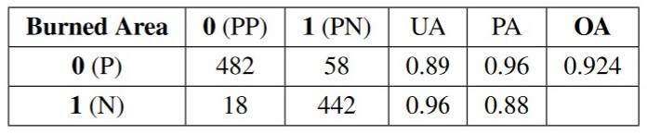

Slide 16
Thanks for your attention!
lorenzo.carlassara@mail.polimi.it
Geoinformatics Engineering
All materials in this presentation are from the public literature and internet. Use herein of copyrighted material is purely for academic purposes.

